Slide 1
Microsoft Reactor AI @ Industries
Wai Man Hui Cloud Solution Architect
Kenneth Kwan Senior Consultant – AI & CCoE, Industry Solutions

Slide 2
Agenda
1
AI in Different Industries
2
Industry Solutions and Reference Architectures
Adoption Framework
AI Foundation
3 Solutions
3
PTU and how we can leverage it
4
Latest AI Updates

Slide 3
AI Reinvent ALL Industries
HR
Internal HR Assistant
Materials summarization (Enterprise chat bot)
Summarization of surveys, Exit interviews
Job Ad. Creation
Supply Chain
Invoice/PO Processing – Data Extraction
Contract Analysis
Logistics Prediction
Order Changes Tracking
R & D
Report Summarization
Summarization of external content esp. patent
Intellectual Properties Creation
Product Development
Generate product code from design docs/pseudo-code
Defect Detection and Fixing
Code Modernization
Documentation Generation
Admin and Support
Summarize emails, calls, and other communications
Travel Advisor
Admin Task Priorization
Legal
Legal / Contract Document Summarization
Draft Document Generation
Marketing
Content Creation (website, social media, email, etc.)
Content Summarization
Audience Segmentation
Sentiment & Temperature Analysis
IT
Enterprise IT Bot
Incident Analysis
Documentation Generation
KB Content Creation
Support & Incident Routing
Customer Service
Call Center Analytics
CS Response Creation
Request summarization
Customer-facing Bot
FAQ Content Creation
Environment, Health & Safety
Document Creation
EHS Procedures Content Creation
Enterprise Incident / Safety Bot

Slide 4
Journey for AI Adoption
AI Strategy
AI
Plan
AI
Ready
Govern
AI
Manage
AI
Secure
AI
AI Readiness & AI Foundation
Design & Govern AI Workloads
Manage & Secure AI Workloads
Responsible AI Principles
Adopting AI on Azure - https://learn.microsoft.com/en-us/azure/cloud-adoption-framework/scenarios/ai/

Slide 5
Industry Agnostic
Industry Agnostic – Thoughts
Prioritized / Top Demanding Use Cases
Internal / HR Assistant
Internal assistants streamline how employees access information about internal policies, HR documents, and help automate common administrative tasks. This keeps employees focused on more complex and higher value tasks aligned to their job function, saving time and increasing productivity.
Industry Vision
Organizations of the future empower their knowledge workers with information and intelligent tooling on demand. This knowledge touches all internal operations. Internal processes and policies become easier to navigate with intelligent HR assistants, internal and external document repositories can be mined for insightful product management and business intelligence, and developer productivity can be amplified. Even customer relations will be transformed, with constant coaching and recommendations available in contact centers.
Contact Center
Customer service has been revolutionized by intelligent contact centers leveraging generative AI. This AI assistant empowers customer service agents with the data from internal documents, policies, and procedures. Agents are supported before, during and after customer service calls with AI services, recommendations, and coaching.
Document Intelligence and Knowledge Mining
AI can significantly enhance document intelligence by automating the extraction, aggregation, and summarization of data from various document types, such as webpages, contact center logs, research papers, internal documents, or security filings. This information can be used in downstream processes from algorithmic trading, compliance monitoring, product strategy, and portfolio analysis.

Slide 6















AI Landing Zone
Strong AI Foundation provides the core infrastructure and resource hierarchy that support AI workloads in Azure. It includes setting up scalable, secure environments that align with governance and operational needs. It enables efficient deployment and management of AI workloads, also ensures enhanced security and flexibility for future growth.
Foundation AI Functions
AI Foundation
API Gateways
Microsoft Fabric
Azure AI Search
OpenAI
Azure DevOps
Routing, Tracking & Circuit Breaker
Model Catalog & Fine-tuning
Cosmos DB
Azure AI Studio
Key Vaults
Facade
OneLake
Notebook
Compute Cluster
Orchestration & Evaluation
Azure Cache for Redis
App Insights
Unified Data Lake
Data Transformation
ML Deployment
Unified Platform for GenAI-driven AI apps
Data Factory
Power BI
Doc Intelligence
Azure Al Services
Vector Indexes
Azure Monitor
AKS Cluster
Microsoft Purview
Managed Identity
Data Pipeline
Real-time operative dashboard
Document Extraction
Vision, Speech, Language Features
Compute
Data Engineering
Artificial Intelligence
Governance

Slide 7
Scaling from Zero
Effort
Large-scale AI Foundation
Well-Architected AI Governance Framework
Medium-scale AI Foundation
Custom AI Governance Measures & Setup
Minimum AI Setup / Copilot
Default Governance
Complexity

Slide 8




Industry Use Case #1 : Internal / HR Assistant
Reference Architecture
Document Ingestion & Management
Answering/End user
Admin UI
Configure chunking & prompts; upload new documents
Speech Service
Chat interface for users
Doc Intelligence
Extract from documents
Function Apps
Read files, process, chunk, embed, and store results
Azure Al Search
Stores extracted documents and embeddings
Chat Frontend (JS) + Backend
Chat interface for users
Create embeddings
Ingest documents
Read documents
Azure OpenAI
Storage Accounts
Stores raw documents
Reasoning over documented chunks
AI Foundation
Chat with your data
This combines the capabilities of document retrieval and response synthesis to create a conversational search experience for internal users.
Chat with Your Data Solution Accelerator - https://github.com/Azure-Samples/chat-with-your-data-solution-accelerator

Slide 9



Industry Use Case #2 : Contact Center / AI Assistant
Reference Architecture
Container Registry
The resulting transcriptions and extractions are stored in an Azure storage container along with the enriched metadata (diarization, sentiment, etc.)
Azure AI Search
Microsoft Fabric Synapse Data Engineering Pipeline
Web Front-end to navigate the indexed data for search UI
Continuous Export
App Service
Sources
Storage Account
Knowledge Indexes
AOAI
OneLake
Notebook
`
Evaluation
As processed documents, recordings and text-based conversations are uploaded in the storage they trigger the automatic batch transcription and extraction jobs
Prompt Flow
Cosmos DB
Storage Account Mounted to OneLake
Process, Enrich, Vectorize and Index
Data Engineering
Azure Al Services
Store Chat Record & GenAI Outputs
AI Foundation
AI Functions
Also known as a “custom copilot”. A custom copilot for enterprise applications performs two things:
Search/summarize data through a chat UI and/or
Task completion within the enterprise app using private or public data.
Build your own AI Assistant
Build your own Copilot (Client Advisor) - https://github.com/microsoft/Build-your-own-copilot-Solution-Accelerator/blob/main/ClientAdvisor

Slide 10
Industry Use Case #3 : Enterprise Search & Knowledge Mining
Reference Architecture
The resulting transcriptions and extractions are stored in an Azure storage container along with the enriched metadata (diarization, sentiment, etc.)
Web Front-end to navigate the indexed data for search UI
Azure AI Search
App Service
Microsoft Fabric
Continuous Export
Sources
Storage Account
Indexed Knowledge Articles
OneLake
Notebook
Azure OpenAl
Container Registry
As processed documents, recordings and text-based conversations are uploaded in the storage they trigger the automatic batch transcription and extraction jobs
Storage Account Mounted to OneLake
Process, Enrich, Vectorize and Index
GenAI Models
Azure Al Services
Data Engineering
Non-GenAI Capabilities
AI Foundation
AI Functions
Enterprise Search and Knowledge Mining
AI can significantly enhance document intelligence by automating the extraction (incl. transcribing), aggregation, and summarization of data from various document types, such as webpages, contact center logs, research papers, internal documents, recordings, and security filings.
Conversational Knowledge Mining Solution Accelerator - https://github.com/microsoft/Customer-Service-Conversational-Insights-with-Azure-OpenAI-Services

Slide 11




Use Case #3 : Enterprise Search and Knowledge Mining
Customer Solutions
FSI
Utility
Business Users
Container Registry
Search UI
Call and Text Recordings
Azure AI Search
App Service
Microsoft Fabric
Doc Mgmt UI
Storage Account
Knowledge Indexes
App Service
Continuous Export
OneLake
Notebook
Azure OpenAl
Container Registry
Source Knowledge Repo
Automatic batch processing, extraction and transcription
Data Sinking
Vectorization, Indexing and Enrichment
GenAI Models
Azure Al Services
Data Engineering
Knowledge Base Admin
Non-GenAI Features
AI Foundation
AI Functions

Slide 12






Use Case #3 : Enterprise Search and Knowledge Mining
Customer Solutions
FSI
Retail
Utility
Upload triggers workflow
Storage Accounts
Function App
Large Document
Orchestration
API Management
Summarize
data
Summarized Document
Extract
The API returns the requested summaries of the large documents
Document chunks
Summarized chunks
AI Document Intelligence
Azure
OpenAI
AI Foundation

Slide 13
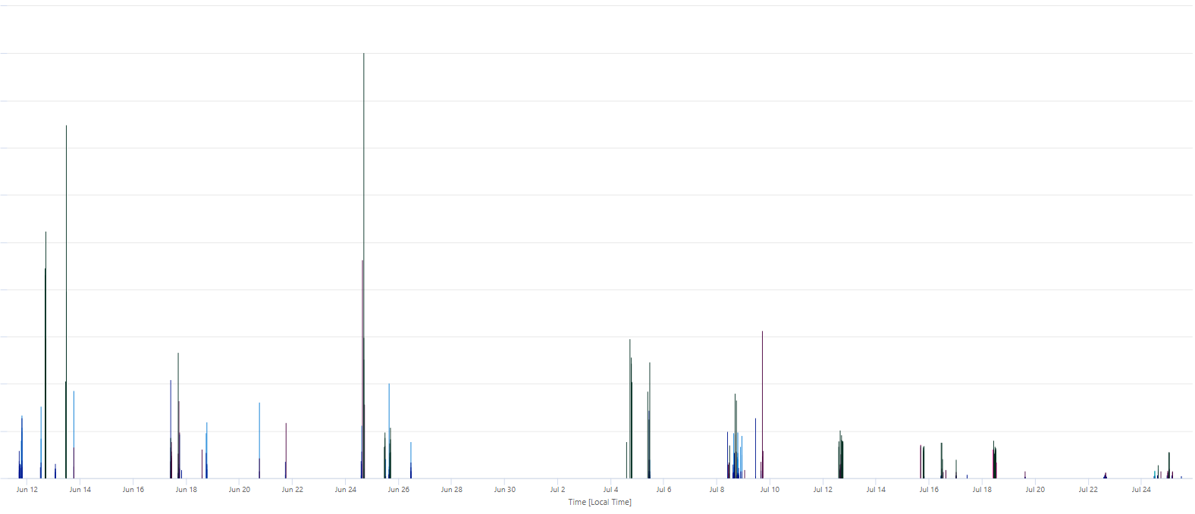
Industry Experience – Adopting PTU Challenges
FSI
Retail
P99 Response Time - 900% faster
✓ Much Stabler
Without PTU
Average Response Time - 500% better
With PTU

Slide 14

PTU Comparison
Pay as you go (PayGo):
Performance is best effort TPMs based upon regional availability
Cost is variable, lower for small workloads, higher for larger workloads and spikes.
No SLA on TPM for PayGo.
Provisioned Throughput Units (PTU):
Performance is guaranteed/predictable (ie. 240k-300k TPMs for GPT-35-Turbo, and 4)
Cost is fixed/predictable, monthly commitments.
SLAs provided for Committed PTUs.
Shared Capacity/Best Effort
Dedicated Capacity/ Guaranteed
Customer B
PTU East US region
Reserved dedicated Compute + GPU capacity
Customer A
Customer A
Customer B
You
East US Region
You
Challenges with PayGo: Assuming an average conversation is ~5k TPM and only 20k TPM capacity is available shared region that is limited/capped, this limits you to only 4 concurrent chat sessions. Users can expect high latency or quota/capacity errors.

Slide 15
What are Provisioned Throughput Units (PTUs)?
Assigned latency per token
Predictable TPM* throughput
Provisioned throughput units (PTU) are units of model processing capacity that customers can reserve and deploy for processing prompts and generating completions.
PTU
Choice in handling traffic
Reserved capacity
*Tokens per minute

Slide 16
Adopting PTU – Choosing the Best Offer
Standard
Provisioned
Flexible deployment options | Easy access with high and predictable throughput
Optimized for low to medium volume workloads | Real-time scoring for large consistent volume
Pay-per-call flexibility | High volume w/consistent low latency
GOOD FOR: Low to medium volume workloads Intermittent usage scenarios Use cases resilient to throughput variability or slowness when service is busy Global or Regional deployment options with inherent data residency policies Sandbox/test environment | RECOMMENDED FOR: Production workloads High volume workloads Throughput heavy workloads Latency-sensitive scenarios Regional deployments

Slide 17
PTU – Provisioned Pricing
Offers you the benefit of flexible and scalable deployment with predictable costs and streamlined billing with significant discounts*
Provisioned | Price
Model and minimum scaling increment |  | Monthly cost per model increment | 1-Year RI Effective Monthly Cost per Model Increment
Current GA models
GPT-4o: 2024-08-06 | 50 units | $13,000 | $11,050
GPT-4o mini: 2024-07-18 | 25 units | $6,500 | $5,525
GPT-4o: 2024-05-13 | 50 units | $13,000 | $11,050
Legacy models**
GPT-4-Turbo: 0409 | 100 units | $26,000 | $22,100
GPT-4: 0613 (32K) | 200 unit | $52,000 | $44,200
GPT-4: 0613 (8K) | 100 units | $26,000 | $22,100
GPT 3.5-Turbo: 0125 | 50 units | $13,000 | $11,050
GPT-3.5-Turbo: 1106 | 50 units | $13,000 | $11,050
Price Reduction!!
Hourly |  | $2/PTU/hr
Reservations
 | One month | $260/PTU/mo
 | One year | $2,652/PTU/yr or $221/PTU/mo
*Customers who intend long-term usage of PTUs may receive a significant discount on the hourly rate by purchasing an Azure Reservation for Provisioned.
***Note retirement dates for legacy models: Azure OpenAI Service model retirements - Azure OpenAI | Microsoft Learn. Use in-portal Capacity Calculator oai.azure.com/portal/calculator. GPT-4 models are in the processing of upgrading to 0409. All pricing in USD above dated on Sept 30, 2024, are subject to change.

Slide 18
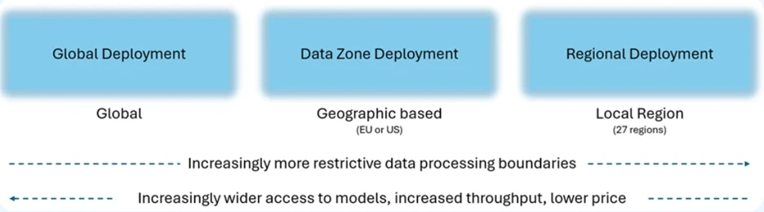
PTU – Deployment Type
Data Zones will be available for both Standard (PayGo) and Provisioned offerings, starting this week on November 1, 2024.
NEW!

Slide 19
Azure OpenAI Service Offerings
Service
Azure OpenAI Service offerings
Offer type
Standard (PayGo)
Batch
Provisioned (PTUs)
Deployment type
Global
Data
Zone
Regional
Global
Global
Data
Zone
Regional
Global deployments leverage Azure's global infrastructure, dynamically route customer traffic to the data center with best availability for the customer’s inference requests.

Slide 20
Latest PTU Price
Start from Nov 1
Deployment option | Hourly PTU | One month reservation per PTU | One year reservation per PTU
Provisioned Global | Current: $2.00 per hour November 1, 2024: $1.00 per hour | $260 per month | $221 per month
Provisioned Data Zone^{New} | November 1, 2024: $1.10 per hour | $260 per month | $221 per month
Regional | $2.00 per hour | $260 per month | $221 per month
Model | Global |  | Data Zone ^{New} |  | Regional
GPT-4o | Min: 50 15 Increment 50 5 | $15/hr $5/hr | Min: 15 Increment: 5 | $16.5/hr $5.5/hr | Min: 50 Increment: 50 | $100/hr $100/hr
GPT-4o-mini | Min: 25 15 Increment: 25 5 | $15/hr $5/hr | Min: 15 Increment 5 | $16.5/hr $5.5/hr | Min: 25 Increment: 25 | $50/hr $50/hr
https://azure.microsoft.com/en-us/blog/accelerate-scale-with-azure-openai-service-provisioned-offering/

Slide 21
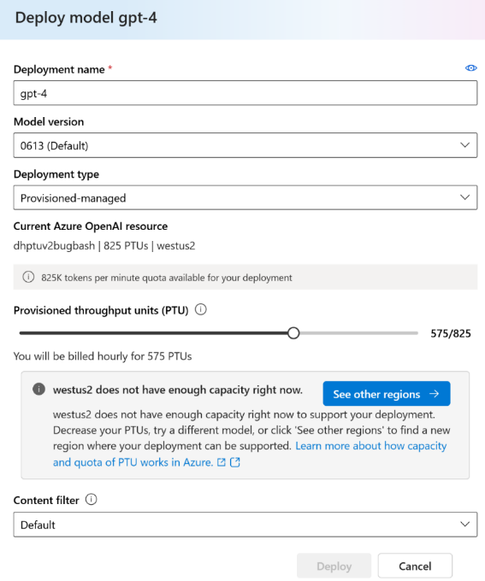
New! PTU – Provisioned Offering Self-service Purchasing
Provisioned self-service quota management:
Easy quota requests via a user-friendly form
Quick auto-approval process to expedite deployment
Flexible model usage:
Quota can be used for any model/version, enhancing flexibility
Default quota allocated in all supported regions for ease of access
Real-time capacity insights:
Transparent access to regional service capacity for better planning
Guided deployment experience offers alternative regions if capacity is full
Incorporate new reservation model:
Discounted Azure Reservations for monthly and yearly commitments
Optional for hourly billing with no-commitment for simplified workload testing and migrations

Slide 22
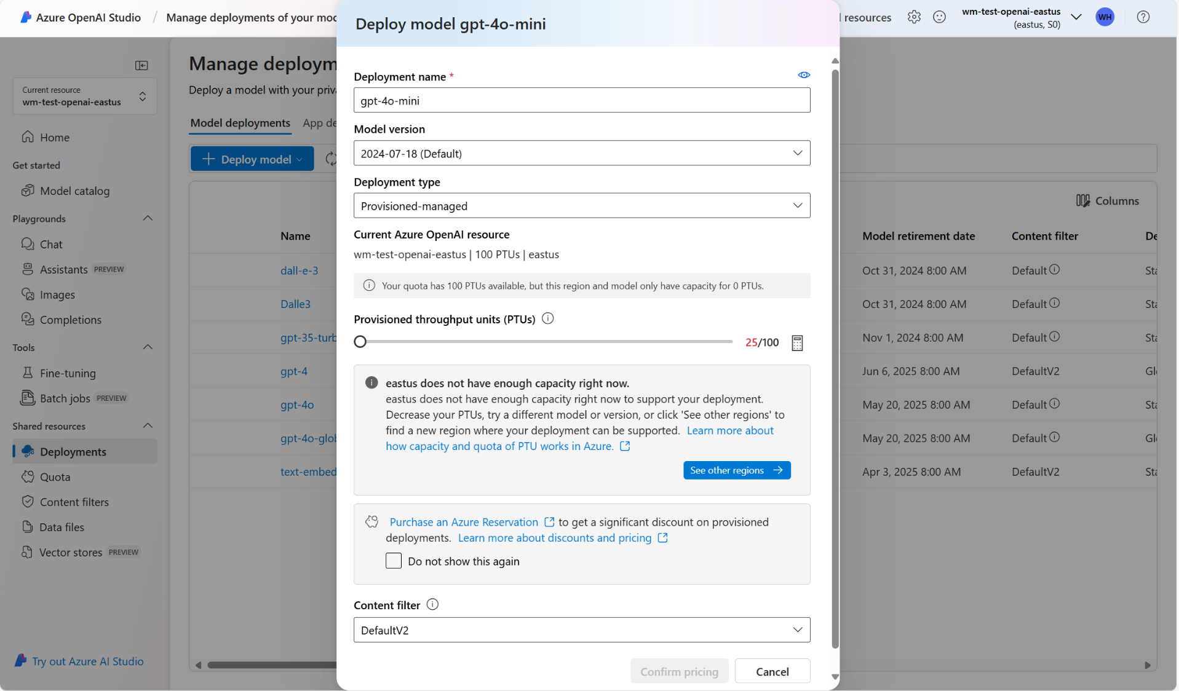

Slide 23
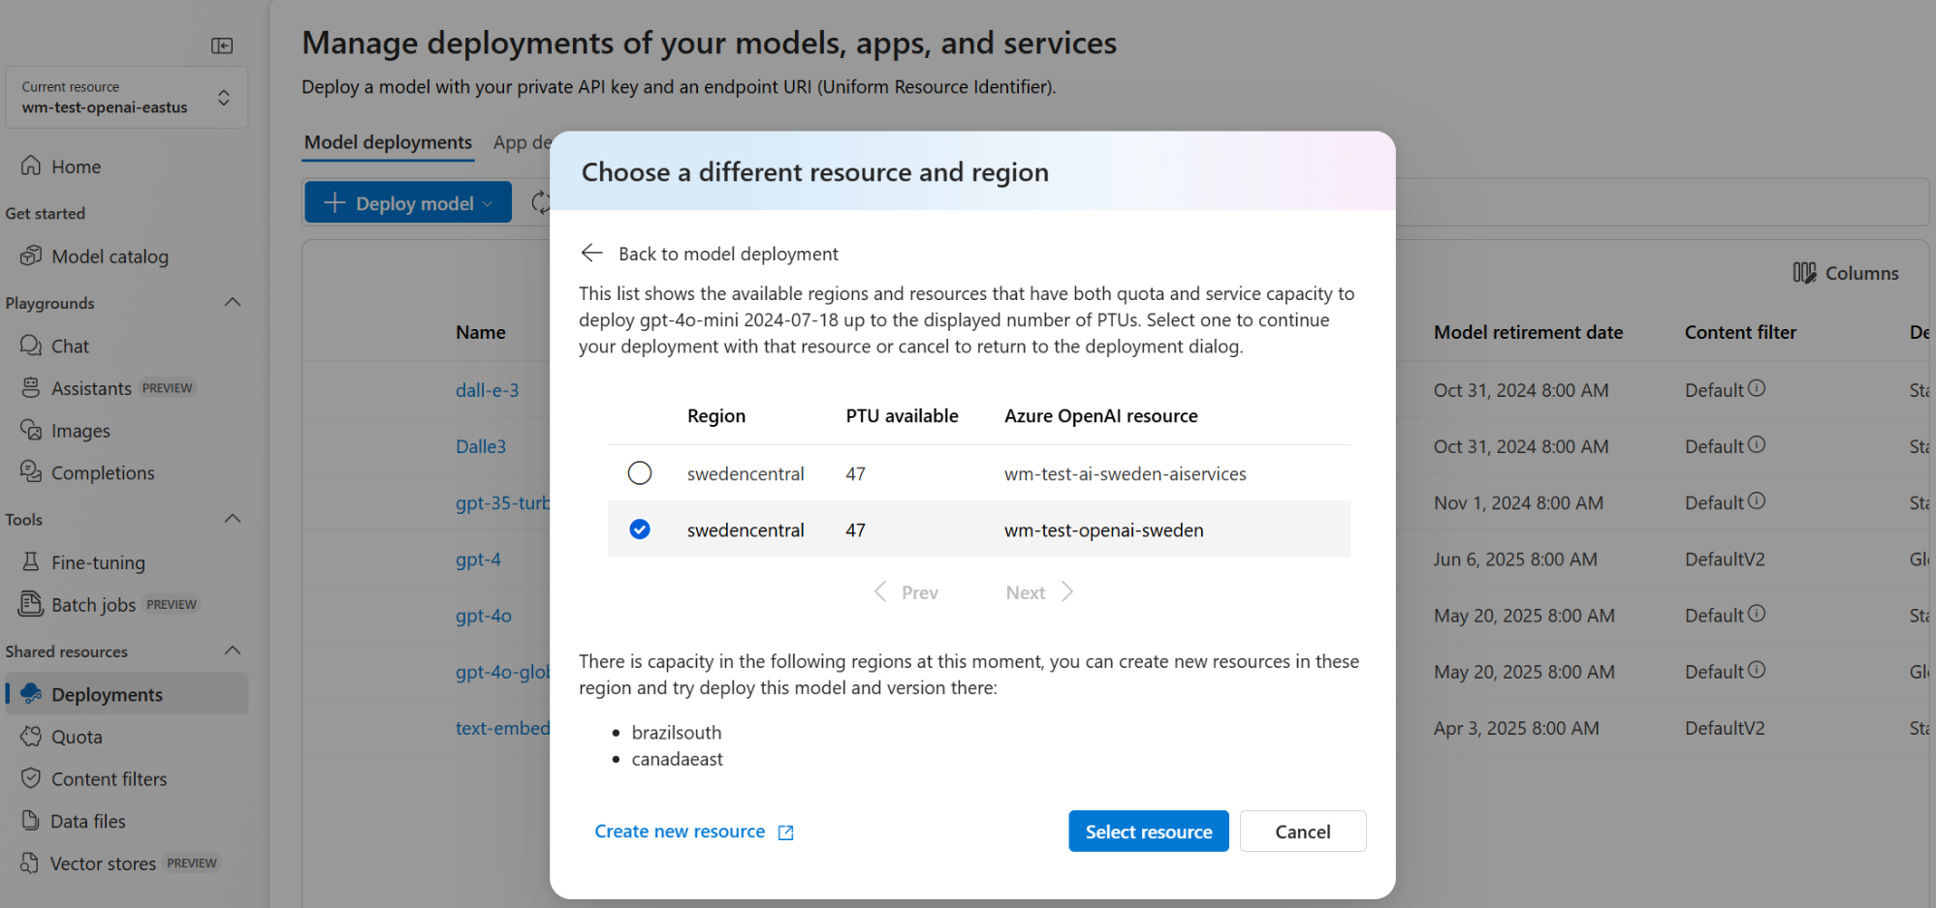

Slide 24
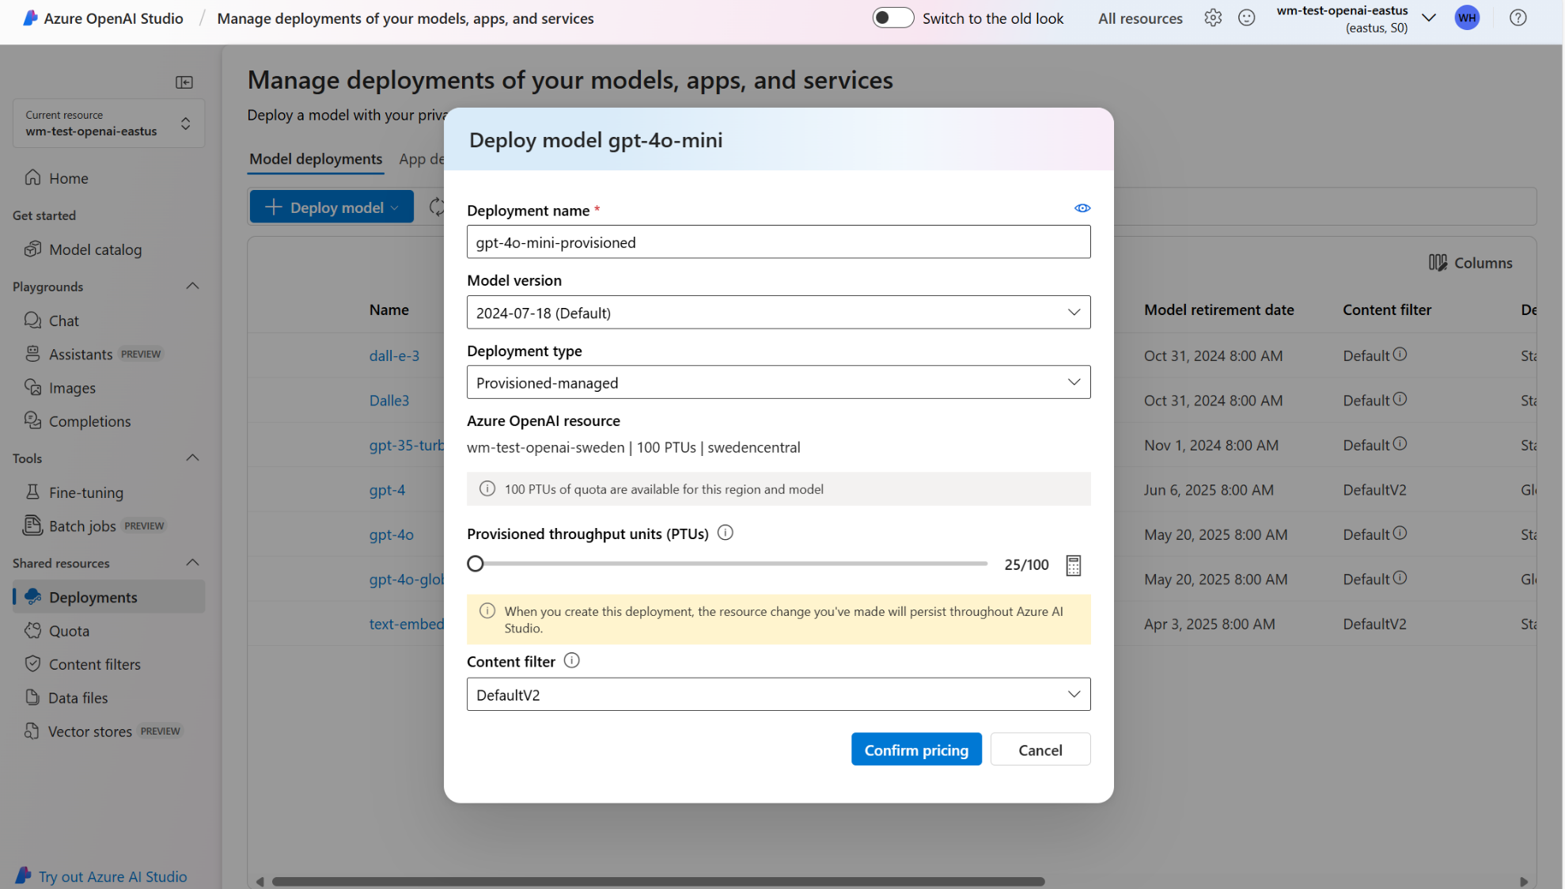

Slide 25
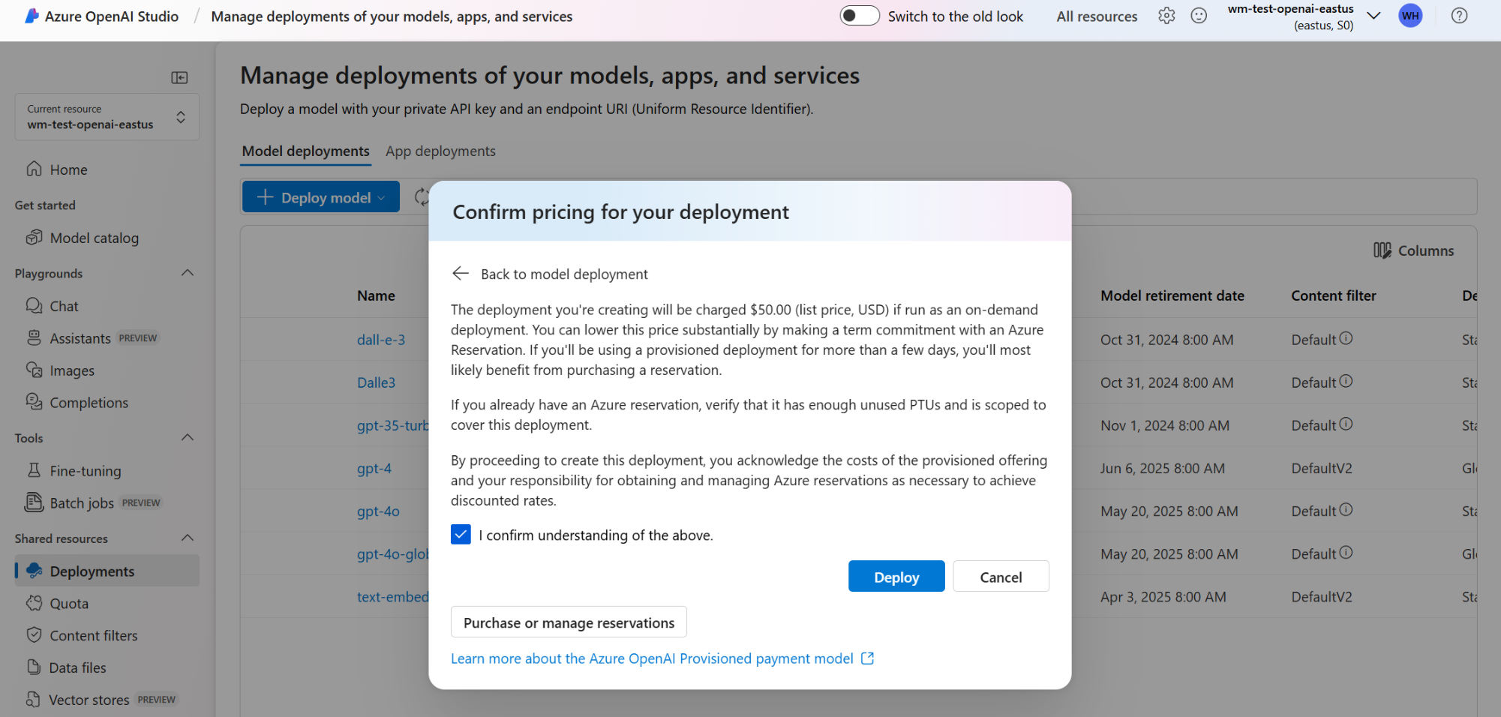

Slide 26
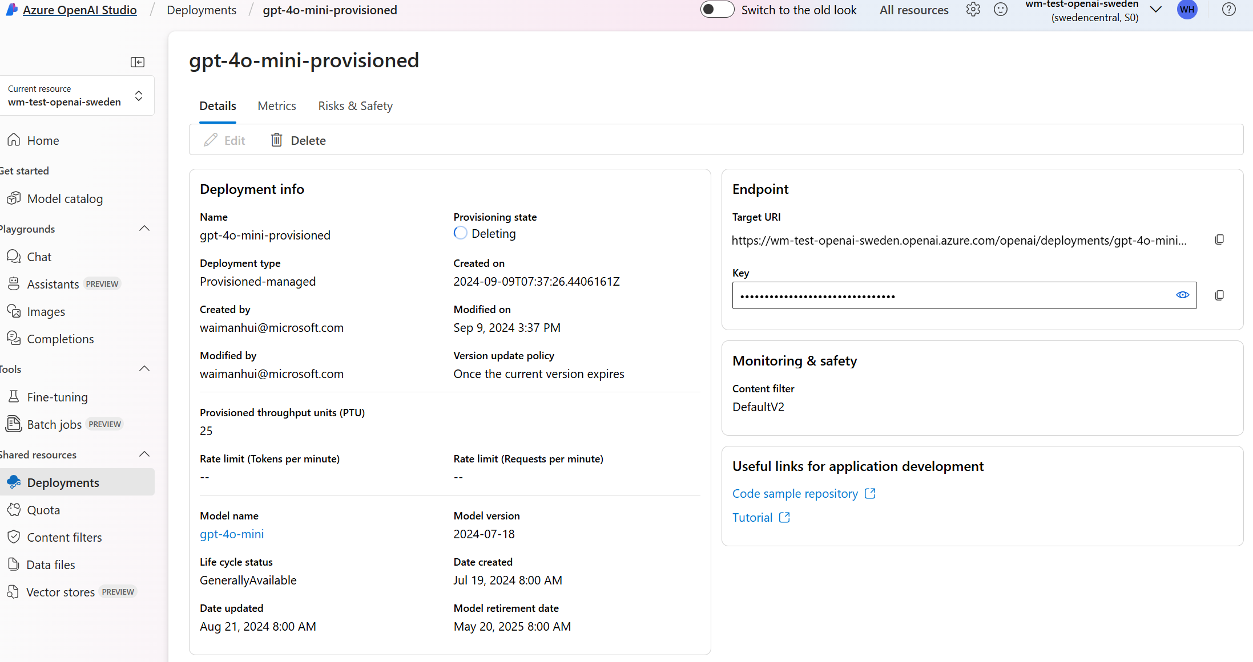

Slide 27
Latest AI Updates

Slide 28
Azure OpenAI What’s new?
September 2024
Azure OpenAI Studio UX updates
GPT-4o 2024-08-06 provisioned deployments
NEW Global provisioned deployment type
NEW o1-preview and o1-mini models available for limited access
Key capabilities of the o1 series
Complex Code Generation: Capable of generating algorithms and handling advanced coding tasks to support developers.
Advanced Problem Solving: Ideal for comprehensive brainstorming sessions and addressing multifaceted challenges.
Complex Document Comparison: Perfect for analyzing contracts, case files, or legal documents to identify subtle differences.
Instruction Following and Workflow Management: Particularly effective for managing workflows requiring shorter contexts.
October 2024
Global Batch GA
o1-preview and o1-mini models limited access (Registration is required, and access will be granted based on Microsoft's eligibility criteria).
New GPT-4o Realtime API for speech and audio public preview
Global batch support updates
What's new in Azure OpenAI Service? - Azure AI services | Microsoft Learn

Slide 29
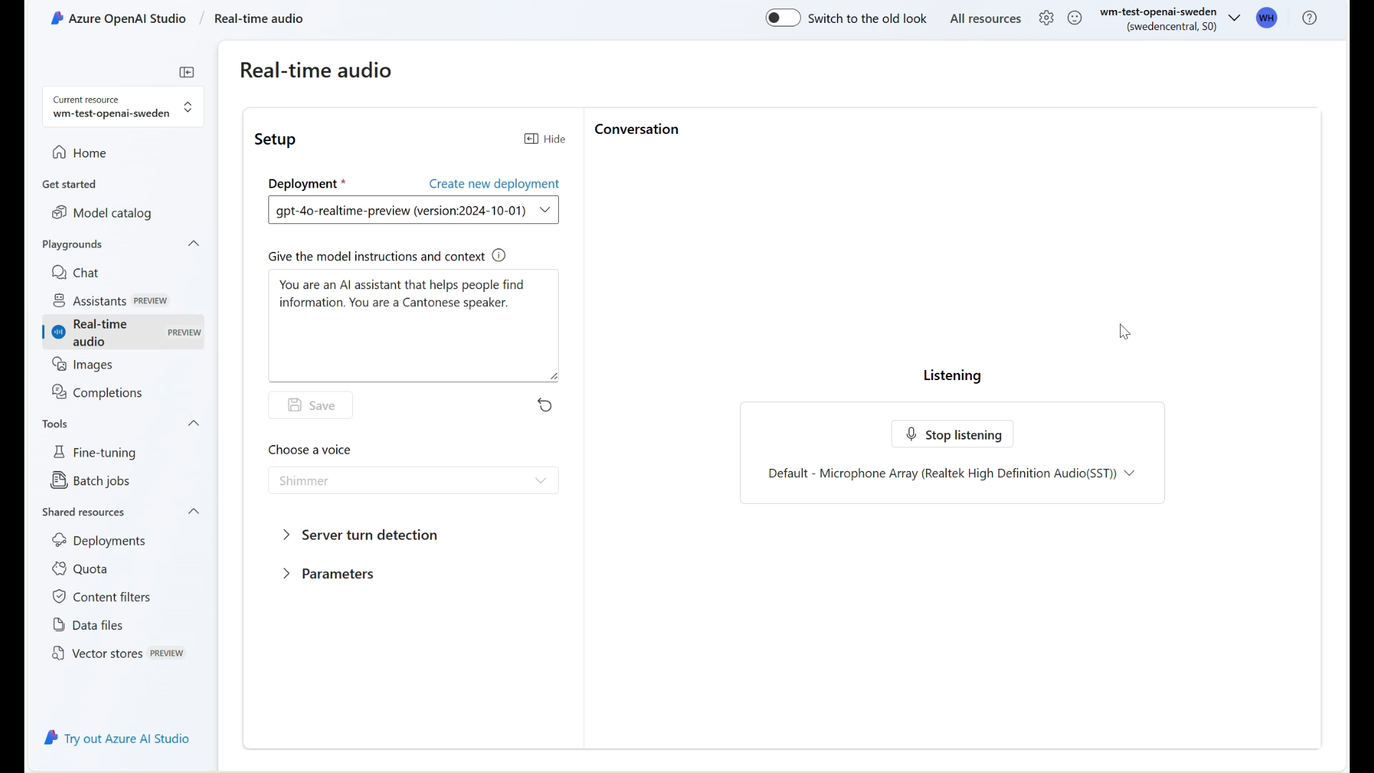

Slide 30
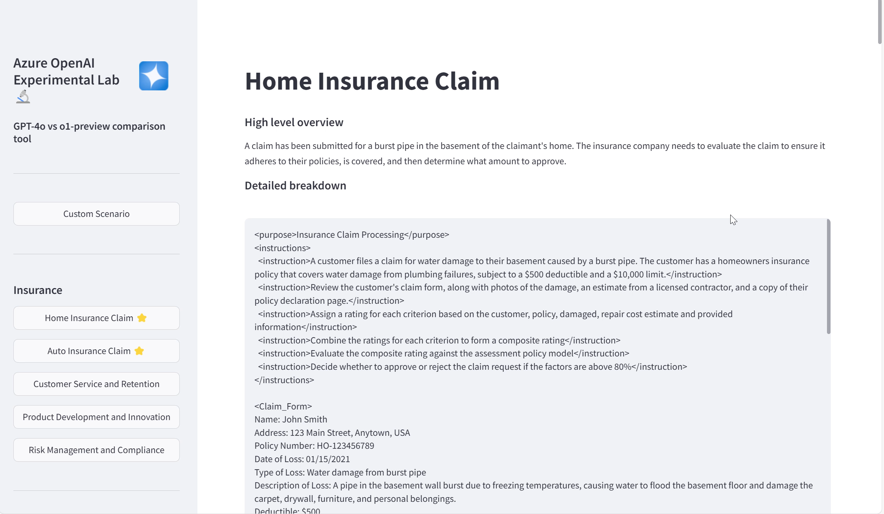

Slide 31







Introducing Video Translation
Now available in public preview!
Localization
Video translation covering global locales
Quality
GPT built-in to optimize the translation content, augmented by content editing
Personalization (limited access)
Keep the original timbre, emotions, intonation & style intact of the original speaker
Batch processed
Video Input
Speech-to-Text
Translation
Content Editing
Text-to-Speech
Output Video
Optional and for prebuilt voices only

Slide 32
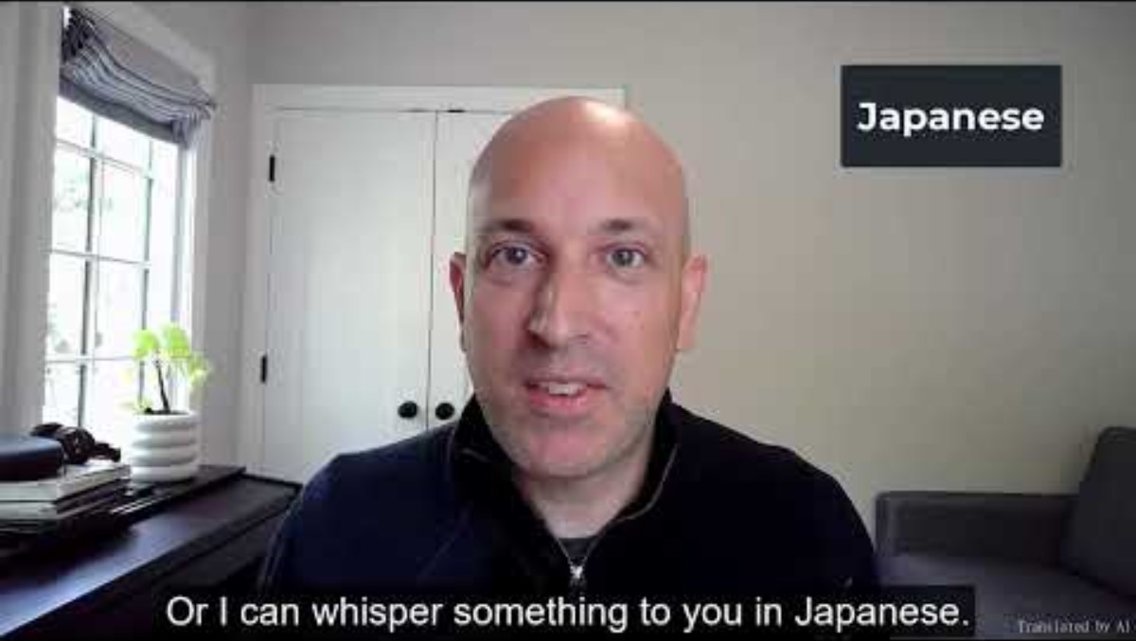
Video translation overview - Speech service - Azure AI services | Microsoft Learn

Slide 33
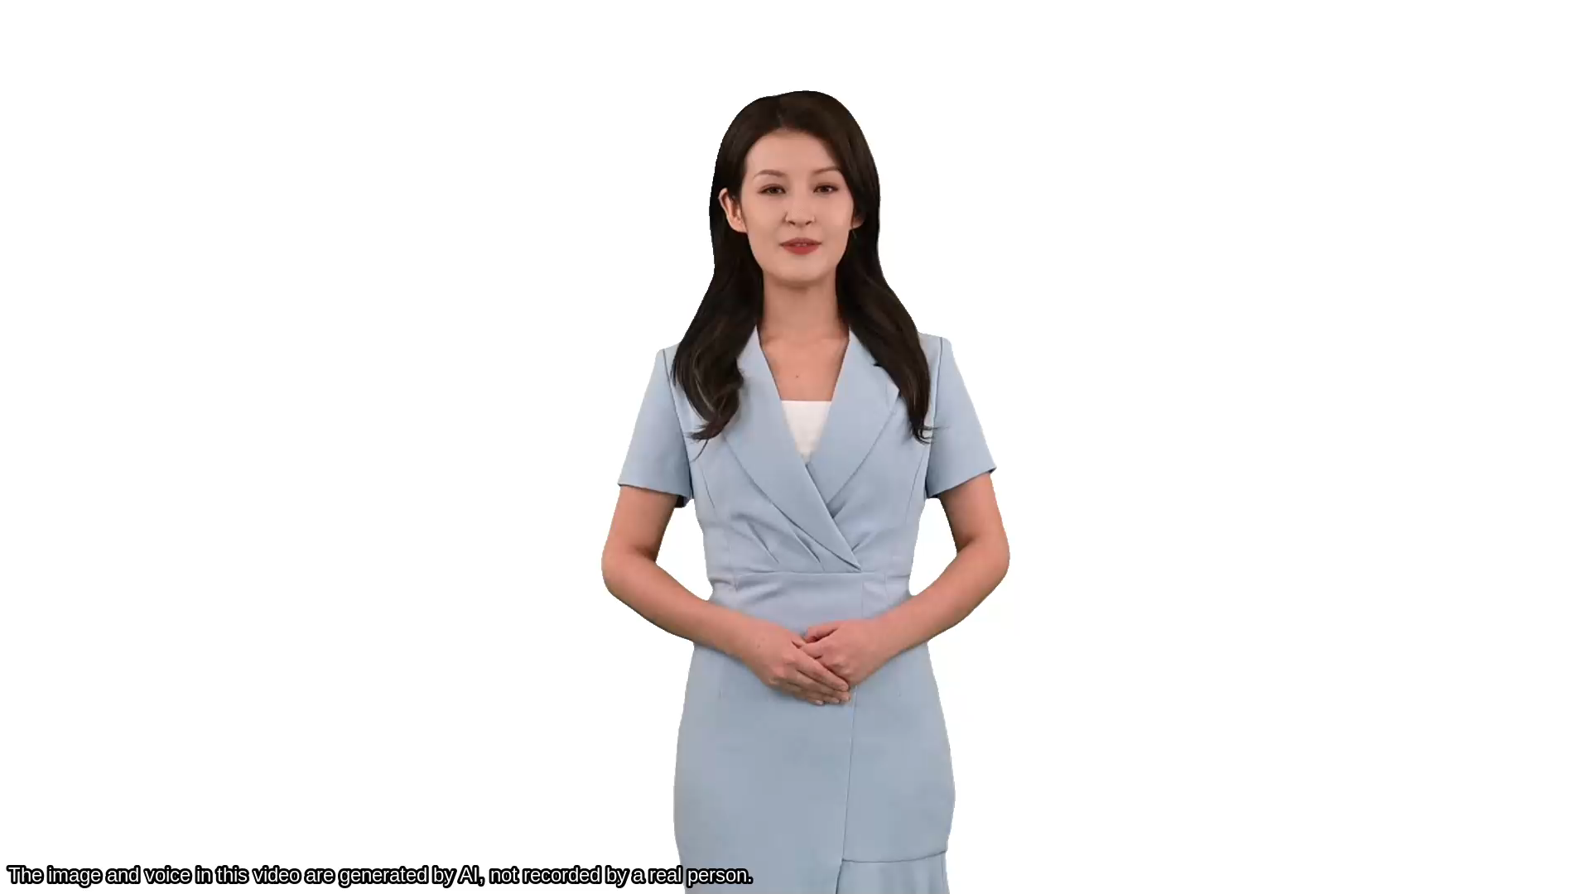
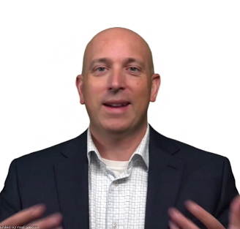





Text to speech avatar
Now GA!
Prebuilt avatar
Custom avatar
Use our prebuilt avatar in content generation or interactive scenarios
Build your own branded avatar with us by providing 10 mins video recording
2D Photorealistic digital humans. The future of virtual interactions
Limited data, maximum output. Our avatar models are trained with minimal video recordings
Text-triggered responses. Create scripts with natural language
Multilingual capabilities. High-quality neural TTS and custom neural voices for global reach
Batch or real-time streaming available
Use cases
Customer service
Live chatbot
Training video
Conference speech
CEO/leader avatar
Promote brand
Live streaming
Ads

Slide 34
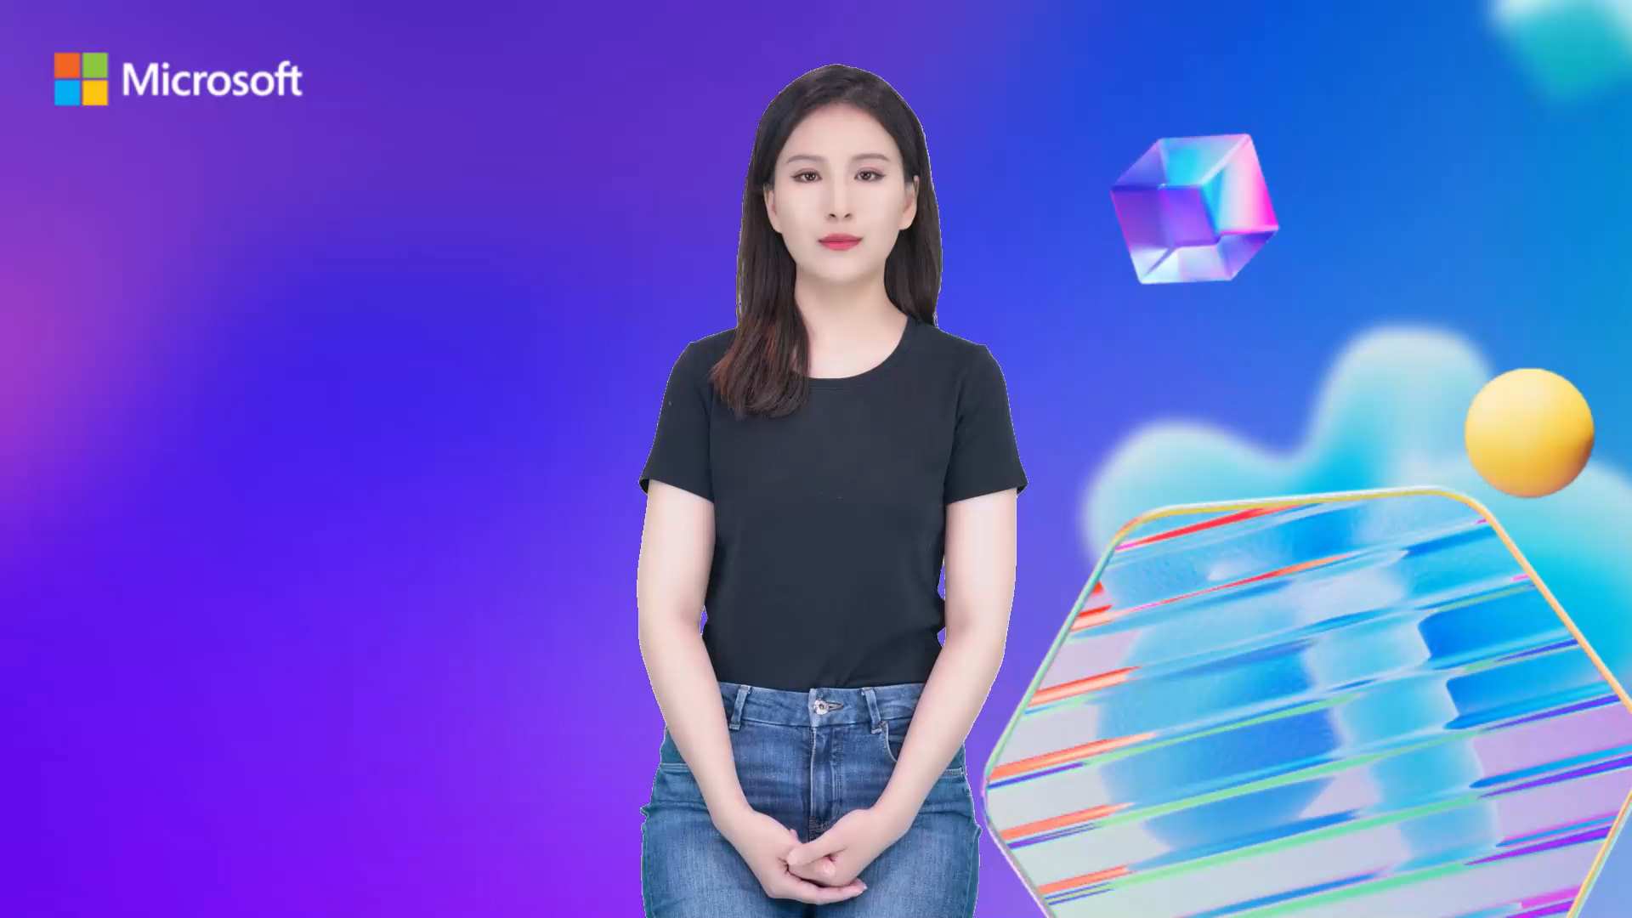

Slide 35

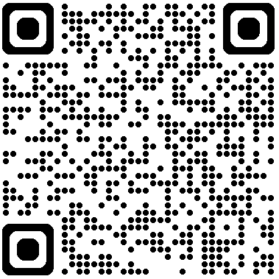
Microsoft Ignite 2024
Experience the latest innovations for AI transformation
Discover solutions that help modernize and manage intelligent apps, safeguard data, and accelerate productivity, while connecting with partners and growing your community or business. Online: November 19–21, 2024 In Chicago: November 19–22, 2024 Optional Pre-day: Afternoon of November 18, 2024
Register Now!
https://register.ignite.microsoft.com/

Slide 36


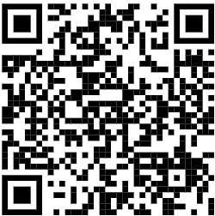
Microsoft AI Innovation Program 2024
Objective:
Accelerate Azure OpenAI Adoption - To speed up practical applications of Azure OpenAI, develop purpose-built solutions in industry-specific scenarios especially Fintech. Gain first-hand knowledge of generative AI to simplify deployment, while optimize costs with full suite of Microsoft products.
Build Ecosystem leverage AI Technologies - To cultivate a vibrant ecosystem of AI enthusiasts, developers, startups, and businesses by serving as a platform for mutual learning, mentorship, and networking, fostering a community that can leverage AI technologies for business expansion.
Benefit:
- 1:1 Technical Enablement (Azure Service)
- 1:1 Business Consultation
- Free Azure Credit
- PR Activities with Microsoft and Ingram Micro
- Social media exposure
Register Now !!!

